Slide 1
TEAM MEMBERS:
Hsin-Hsuan Chung
Preetham Reddy Yaramada​​
Sai Varun Pinna
Simi Maithani
Surekha Maddi
Thi Phan
DENTAL INFORMATICS
INSTRUCTOR: Haihua Chen
Group Number: 1

Slide 2
Table of Content:
Introduction
Goals
Methodology
Data Collection and Cleaning
Data Analysis
Results

Slide 3
Introduction:
In Dentistry, Dental Informatics is concerned with the intersection of Health Informatics and Dentistry as a whole. The field is growing in academic circles as well as within the profession; more dental schools and practices are embracing it. More and more dental schools and dental practices are implementing Electronic Health Records (EHR) systems and Health Information Exchanges (HIEs) are beginning a transformation in health care communications.
This project is aimed at understanding the research progress on Dental Informatics through a bibliometric analysis of the related publications. The first step was to collect all the related publications from the past 20 years: 2001-2020. Different databases were used to extract the publications related to Dental Informatics using the keyword “Dental Informatics”. The data was collected from the following resources: Google Scholar, Web for science, Scopus, Springer, Science Direct, PubMed, PubMed Central, Embase.

Slide 4
Goal:
In this paper, we wanted to determine the article's size, the number of authors, its distribution across publications, its growth rate, its general content, its trend, relation between citations and publications, characteristics of citations, etc..
Research Goals:
Analyzing the total number of articles published each year.
Find the most used and most important words and expressions from a title of articles by using text analysis technique – Automatic Keyword Extraction.
Find the top 10 authors based on their publications.
Analyzing the article and finding their reference article count over the period.
Find the top 10 venue publications based on total number of articles.
Using Intertopic Distance Map (via multidimensional scaling) and finding Most Relevant terms in each topic.
Finding the Coherence and Perplexity score of articles using Topic Modeling.
Analyzing authors collaboration for all articles from 2001-2020.
Finding the most cited paper per each year for Dental Informatics.

Slide 5
Methodology:
We perform different data cleaning operations. In data cleaning different steps are used for converting all into lower case and replacing punctuation marks, stop words, lemmatization, and stemming to get basic word extension.
Topic Modeling using LDA: It builds a topic per document model and words per topic model, modeled as Dirichlet distributions. LDA is a generative probabilistic model that assumes each topic is a mixture over an underlying set of words, and each document is a mixture of over a set of topic probabilities.
Data Mining: EDRs include a wealth of useful information and analyzing it can give insight into how dental practitioners can enhance patient health by recognizing dental illness early. This form of analysis allows dentists to learn from their own data as well as aggregated data from other practices to compare their practice to that of their peers.
Converting to .csv files: Because CSV files have such a simple format, they can be opened and exported by almost any application. It's also simple to convert an Excel file into a CSV file if you need to remove additional formatting and only store your data.

Slide 6
Visualization - In this project, we are using tableau for visualizing our outputs from LDA topic modelling and BERT Topic modelling. Tableau assists users in turning data into useful insights.
Collaborative analysis - To build an author collaboration network, which counts and visualizes the authors work and their collaboration between the articles.We analyse the data and extract the insights information of authors work and create a network graph.
Word Count - Word Count is the technique to find the word with the frequency in the article titles and then we can normalise different forms of words. This technique helps to most frequently used words in the article tiles in Dental Informatics area. We visualise the word counts graph using Tableau.
Citation Analysis - Citation analysis plays a major role in the scientific disclosure of Health informatic area.It is basically finding the citation between the articles based on the authors work. This is the key point to analyse the scientific paper and make decision on the impact of paper.

Slide 7
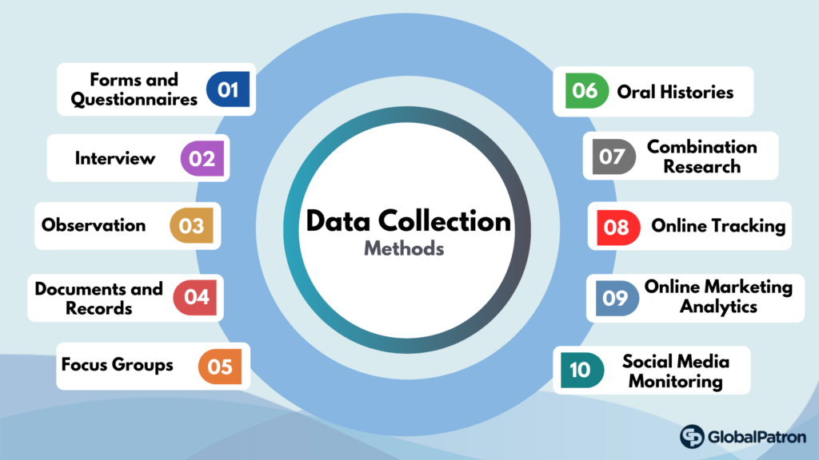
Data Collection
The metadata for each paper includes DOI, title, author(s), Venue (Journal Name or Conference), and publication year.
We then collect the reference (title, author(s), abstract, year, venue) and citation (title, author(s), year, venue, citation in-tent) data based on the DOI information from Semantic Scholar using the Semantic Scholar API.
Semantic DOI API link: https://api.semanticscholar.org/v1/paper/
Pubmed article metadata extraction:
https://eutils.ncbi.nlm.nih.gov/entrez/eutils/efetch.fcgi?db=pubmed&id=22368089&tool=my_tool&email=my_email@example.com

Slide 8
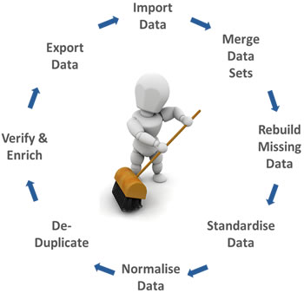
Data Cleaning
Once data is collected, we have performed data cleaning techniques like removing the stop words, punctuations, converting the text into lower case, casting the string data into string data type.
Used python packages called nltk and textblob libraries stopwords, wordNetLemmatizer, etc to perform the data cleaning.

Slide 9
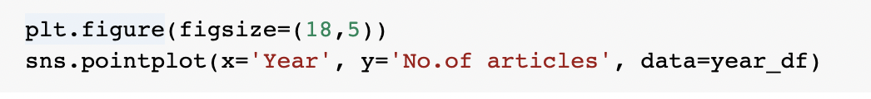
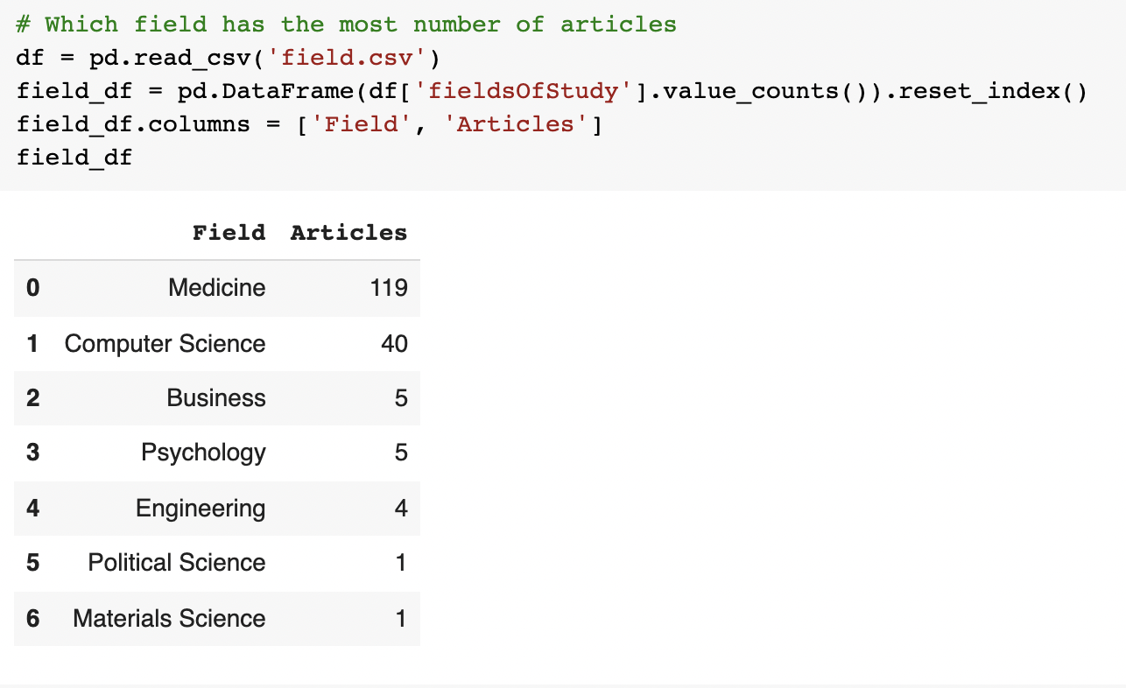
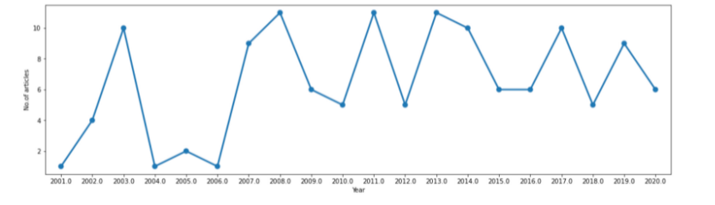
Analyzing the articles published each year:

Slide 10
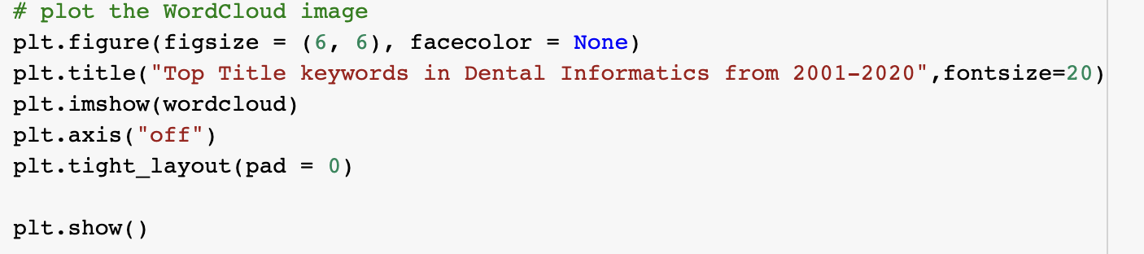
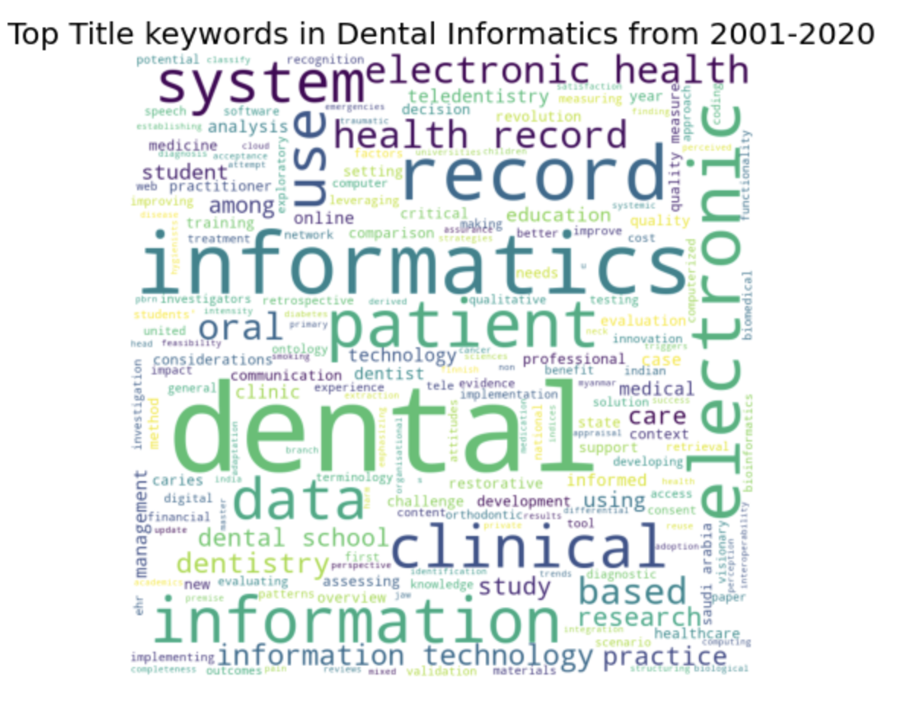
Automatic Keyword Extraction:

Slide 11
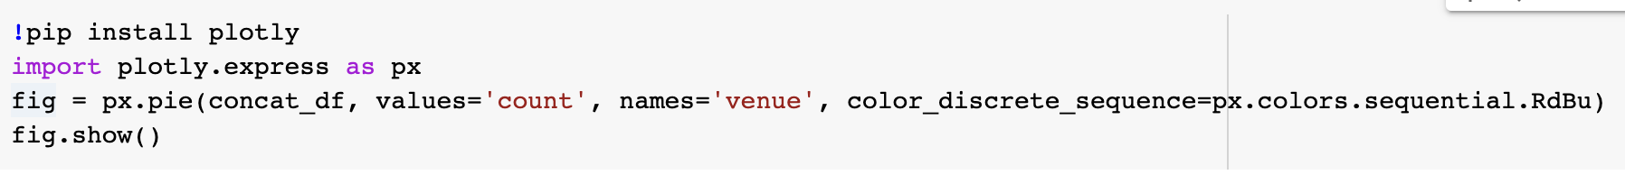
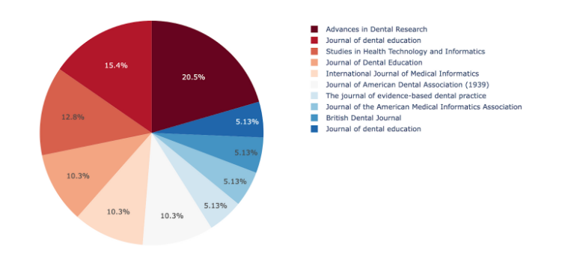
Top 10 Publications based on total number of articles:

Slide 12
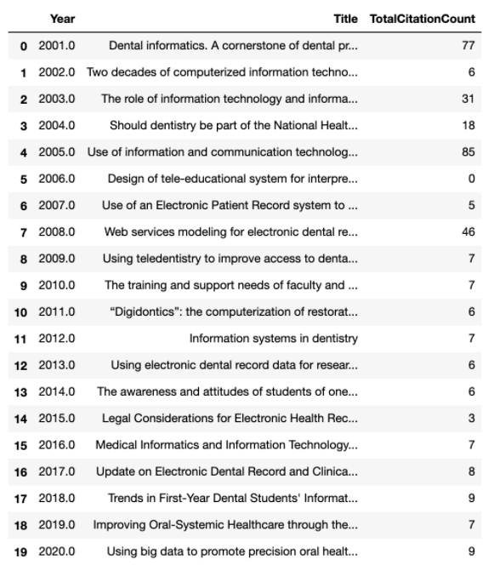
The most cited paper per each year:

Slide 13
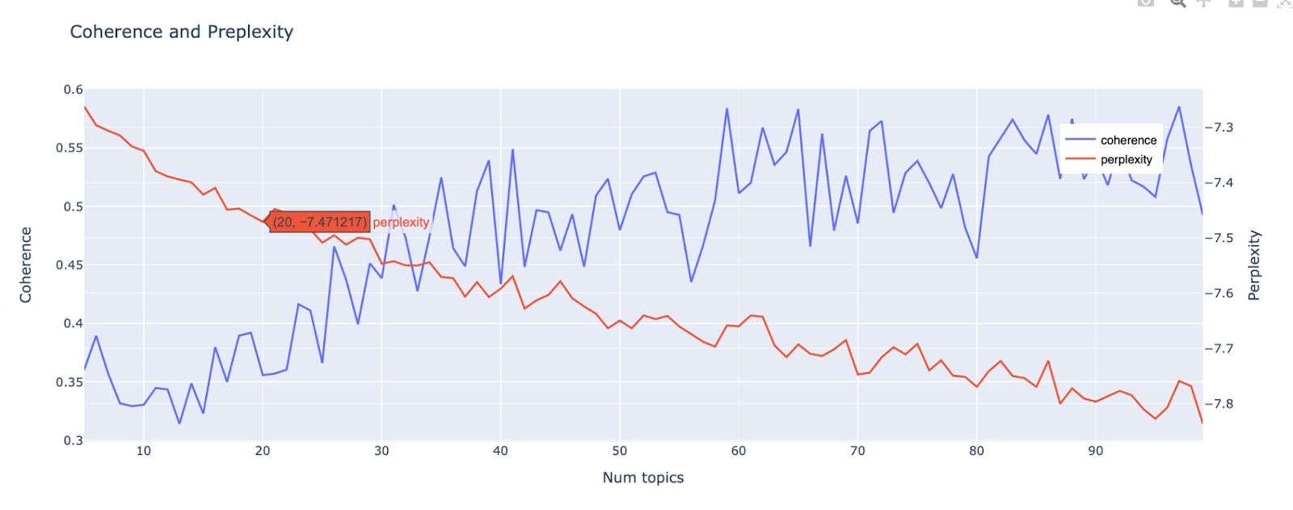
Topic Modeling - Coherence and Preplexity:

Slide 14
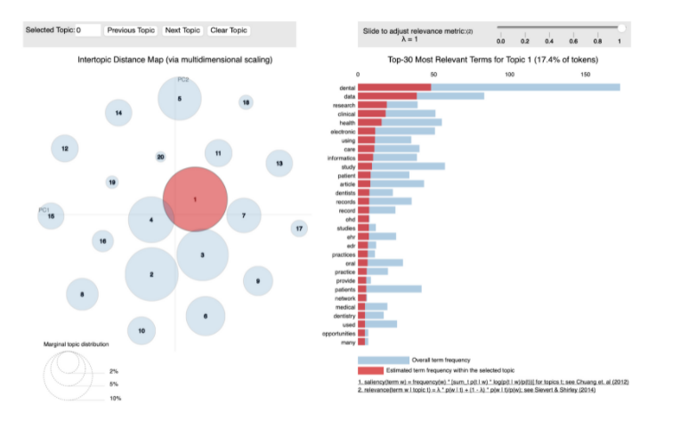
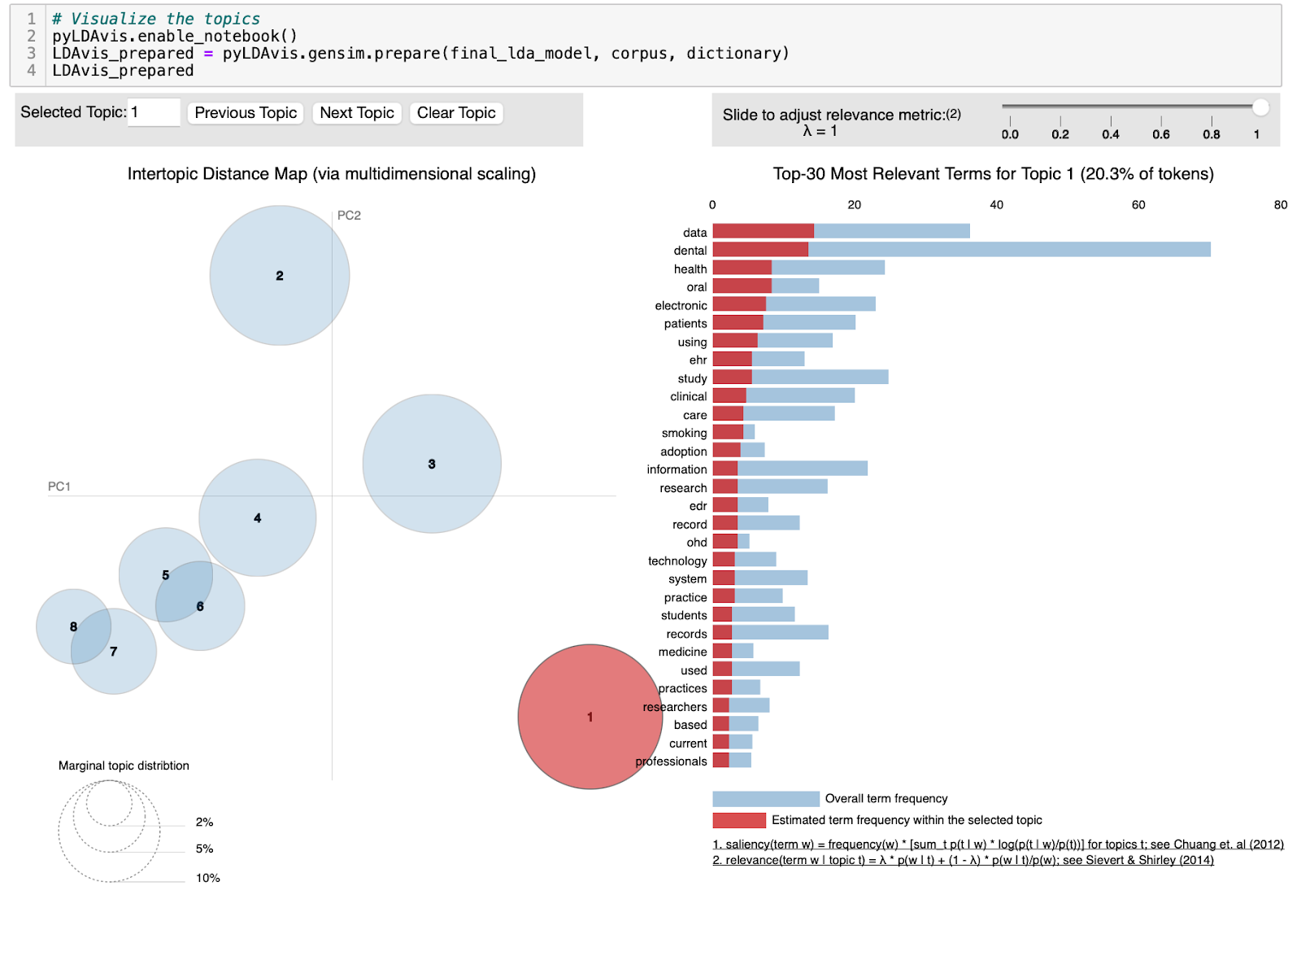
Visualize Topics:

Slide 15
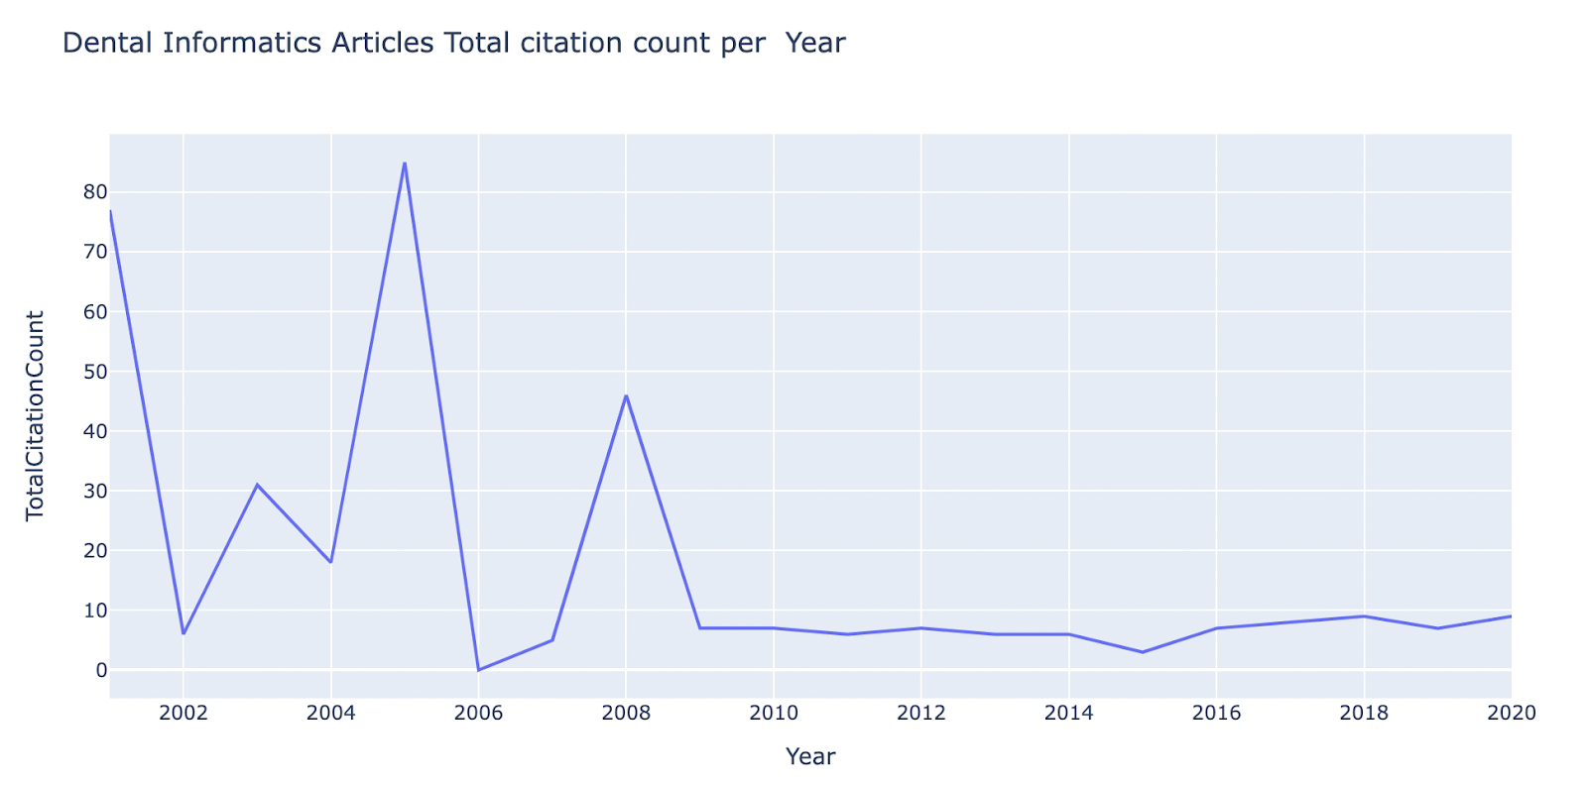
Total citation count per year:

Slide 16
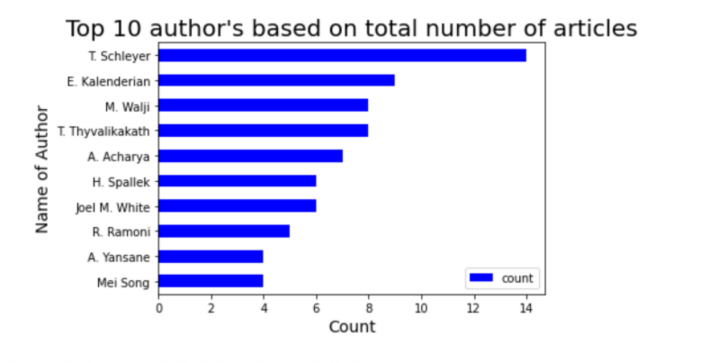
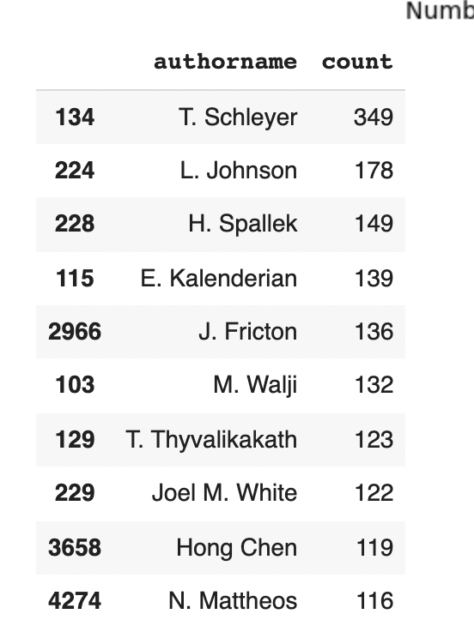
Top 10 Authors based on total number of articles:

Slide 17
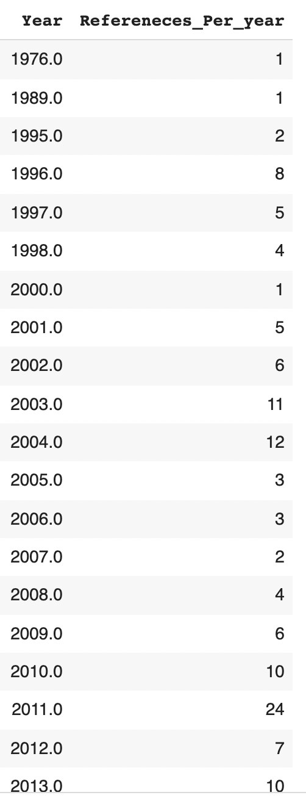
Dental Informatics References per year:

Slide 18
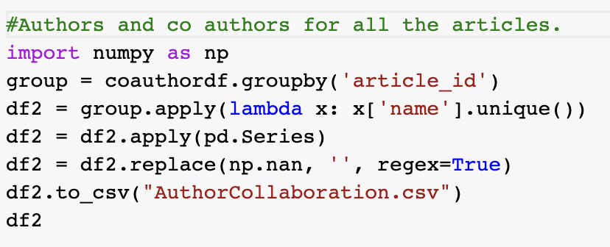
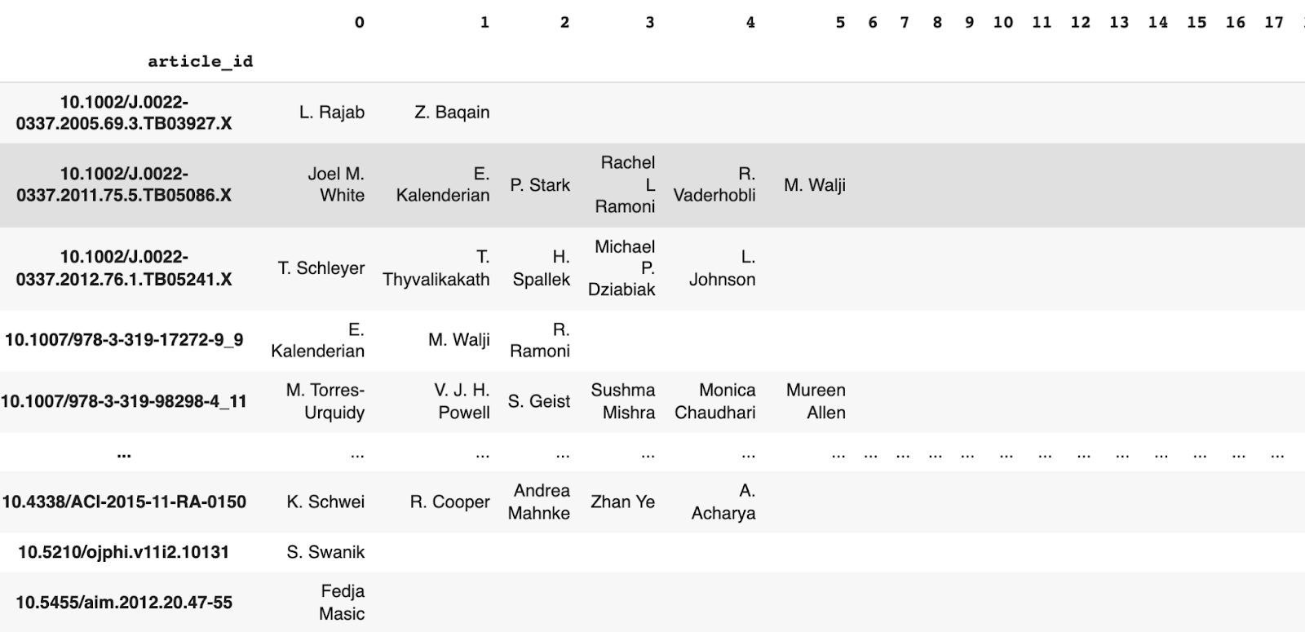
Author Collaboration:

Slide 19
Author Contributions :
• Hsin-Hsuan Chung: Data descriptive Analysis
• Preetham Reddy Yaramada: Visualization
• Sai Varun Pinna: Visualization
• Simi Maithani: Data descriptive Analysis
• Surekha Maddi: Data extraction and author collaboration
• Thi Phan: Topic Modeling
Github link: https://github.com/maddisurekha1234/Dental_Informatics_Project

Slide 20
THANK YOU
ANY QUESTIONS ?

